Slide 1

Nathan Moore, nmoore@winona.edu
Physics and General Engineering
Winona State University
https://ntmoore.github.io/
Everyone eats food, but the Calorie requirements associated with life never quite seem to make it into the Physics textbooks I've used. I think that talking about the food requirements of a family, city, or country can be an illuminating connection to make when talking about energy. Talking about food energy also allows for surprisingly powerful ethical claims about how people have been oppressed in the past.
The talk includes several classroom-ready discussions/problems, featuring: Cannibalism in Aztec culture (was it necessary because they were starving?), The Irish Potato famine (was it a "Natural Disaster"?), and the practicality of living off the land.
Detailed story: https://arxiv.org/abs/2301.06637

Slide 2
These stories have been used with:
Winona State University students
18-22yo
All majors (Engineering, ElemEd, Biology, Business)
Math is mostly unit conversion.
Story+data+question on the slide, “Now talk to the person next to you about what they think…”
Sometimes graded as project or homework
Data, figures, articles, slides are available at: https://github.com/ntmoore/food_energy_paper

Slide 3
First Half of the talk: What is energy?

Slide 4
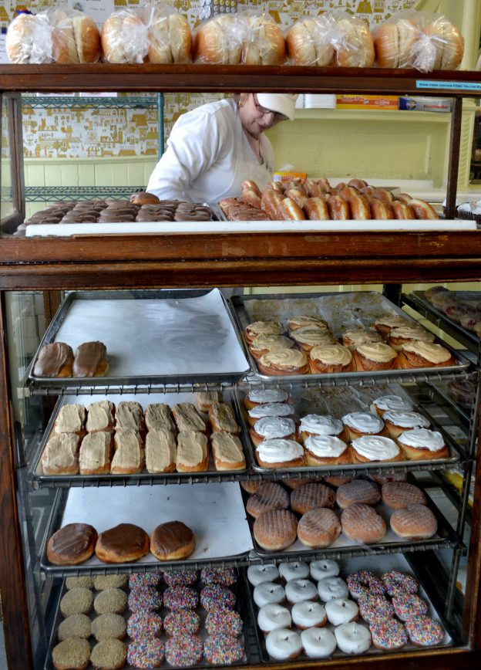
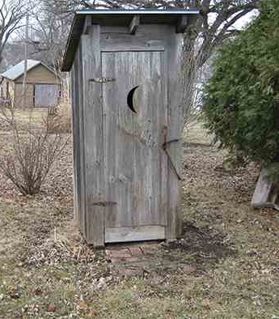

Slide 5
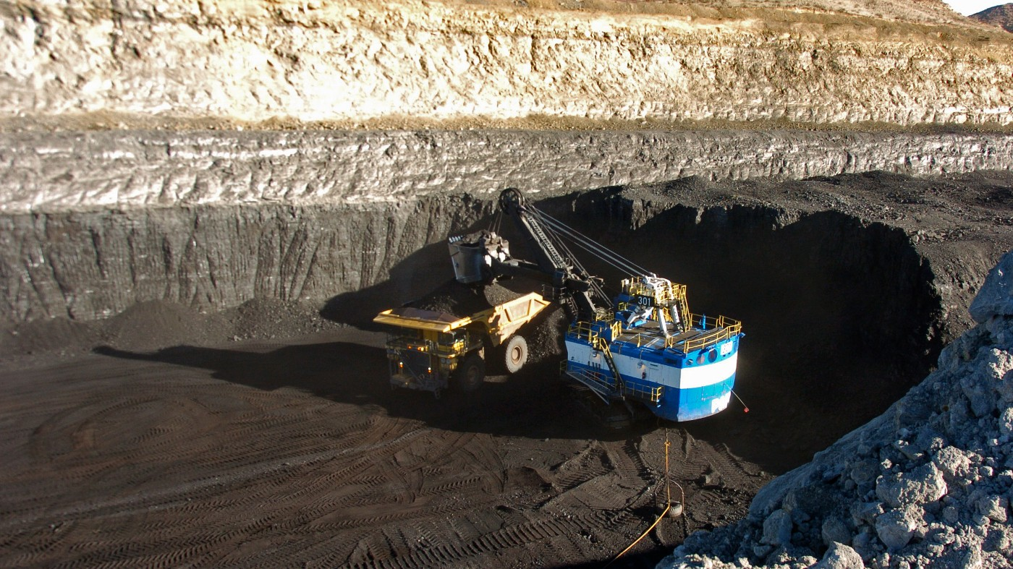
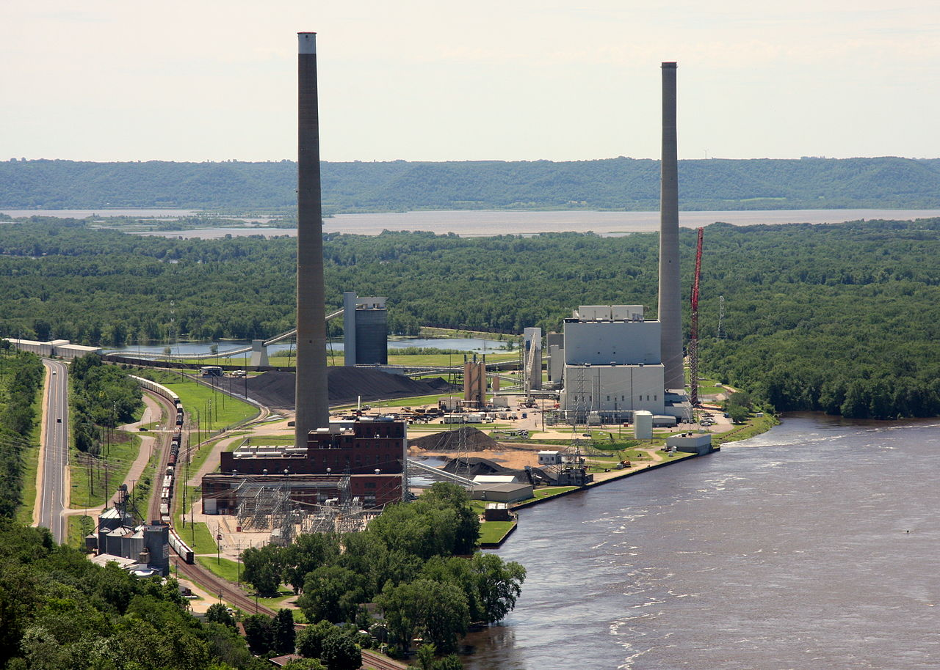
Notes:
https://thehill.com/opinion/energy-environment/3884019-want-to-save-the-climate-buy-a-coal-mine/

Slide 6

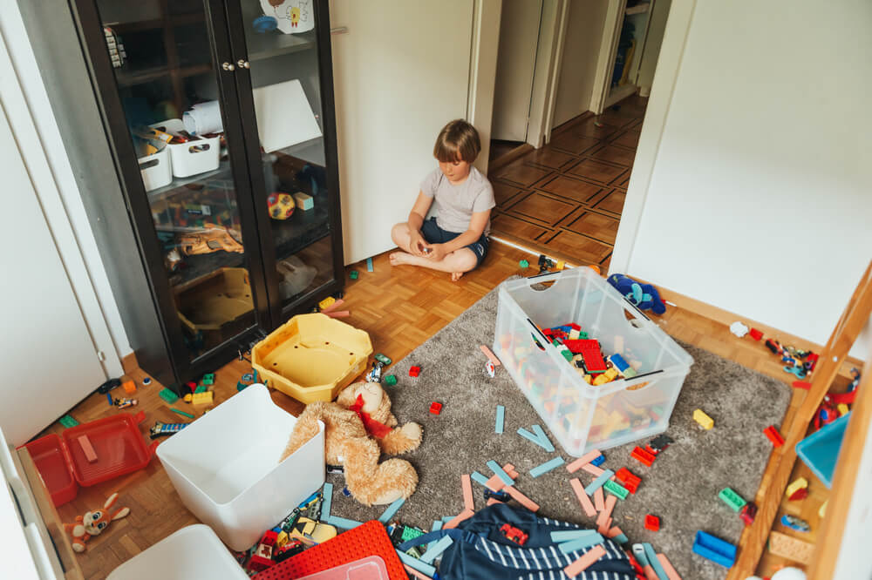

Slide 7
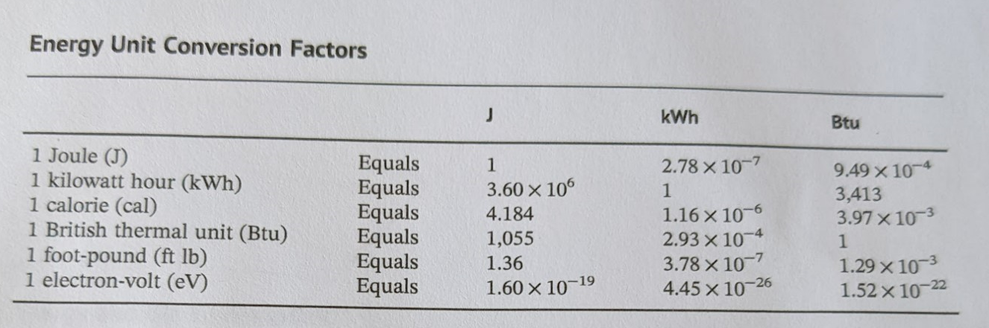
Electric Company
Physics
Hospital Dietician
HVAC
Semiconductors+ Chemistry
Gasoline engines

Slide 8

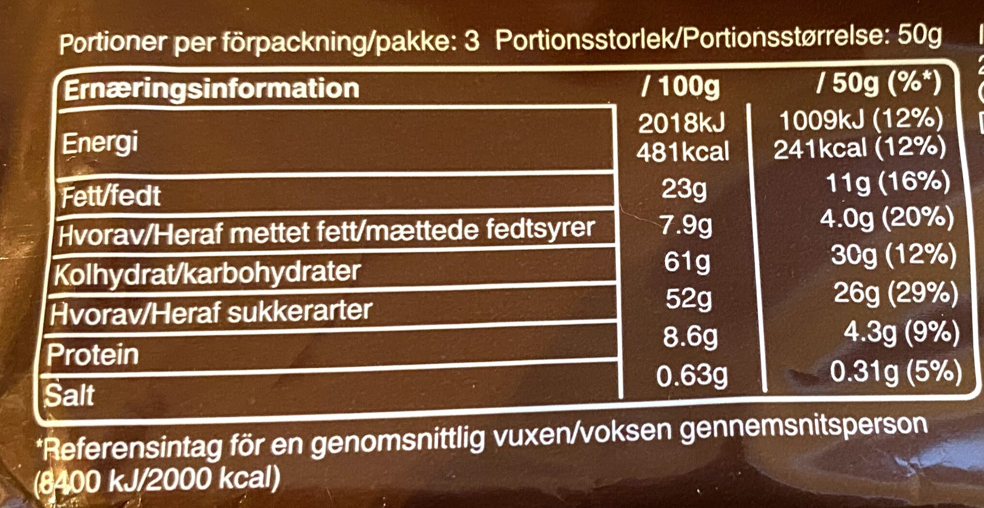
1 kilocalorie (kcal) heats
1 kg Water by 1deg C
Or 1 calorie heats
1 gram of water 1deg C
1 kcal = 1 Calorie = 1000calories
Notes:
https://world.openfoodfacts.org/product/5000159429153/snickers-mars

Slide 9
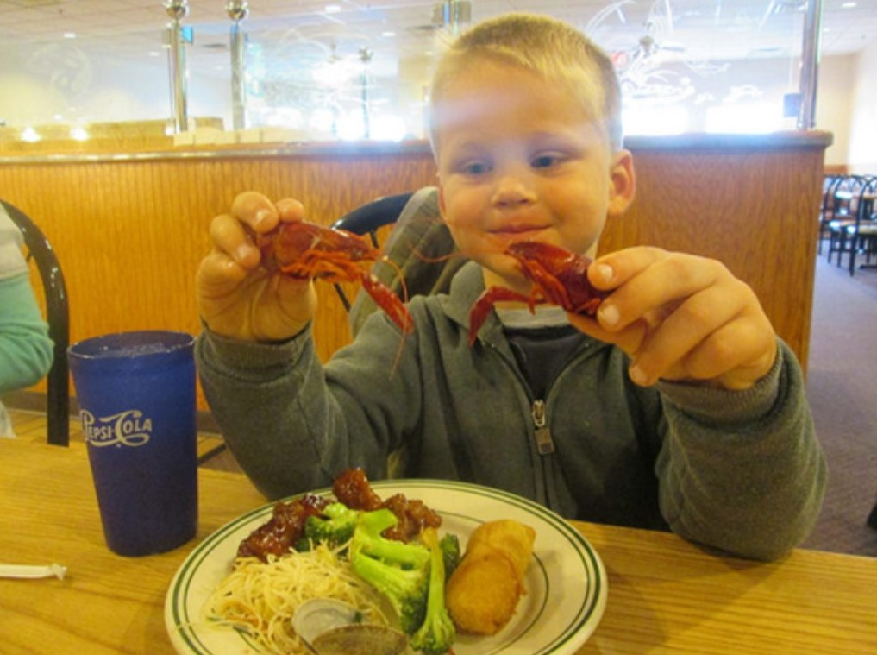
1 kilocalorie (kcal) heats
1 kg Water by 1deg C
Or 1 calorie heats
1 gram of water 1deg C
1 kcal=1 Calorie = 1000 calories
An 85kg college student eats 3000kcals and his body burns it all, immediately…

Slide 10
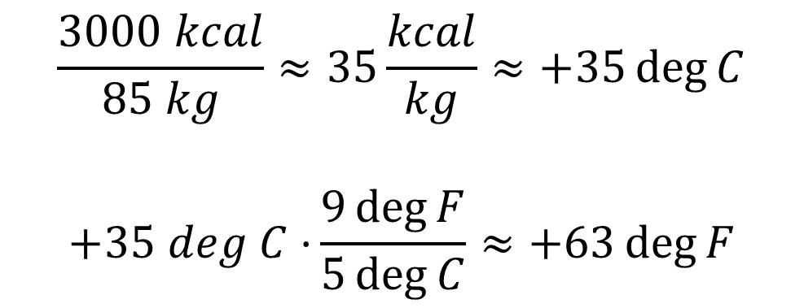
1 kilocalorie (kcal) heats
1 kg Water by 1deg C
An 85kg college student eats 3000kcals and his body burns it all, immediately.
$$\frac{3000 kcal}{85 kg}≈35\frac{kcal}{kg}≈+35\deg{C}$$
$$+35 deg C⋅{\frac{9\deg{F}}{5\deg{C}}≈+63\deg{F}}$$

Slide 11
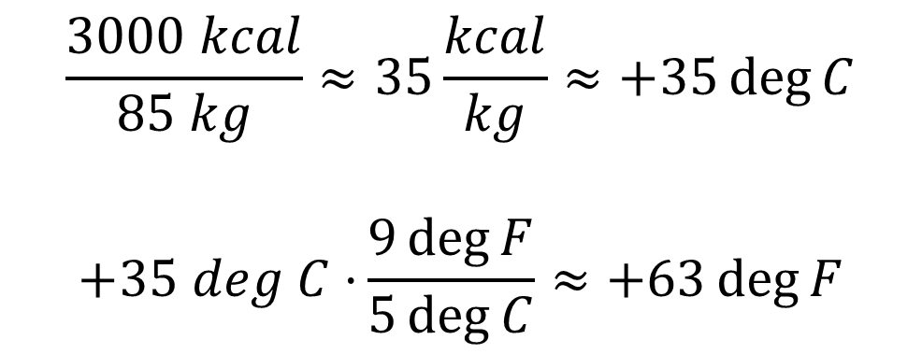
1 kilocalorie (kcal) heats
1 kg Water by 1deg C
An 85kg college student eats 3000kcals and his body burns it all, immediately.
$$\frac{3000 kcal}{85 kg}≈35\frac{kcal}{kg}≈+35\deg{C}$$
$$+35 deg C⋅{\frac{9\deg{F}}{5\deg{C}}≈+63\deg{F}}$$
What’s wrong with this story?
His body temperature rises to … 98.6 + 63 = 162 deg F

Slide 12
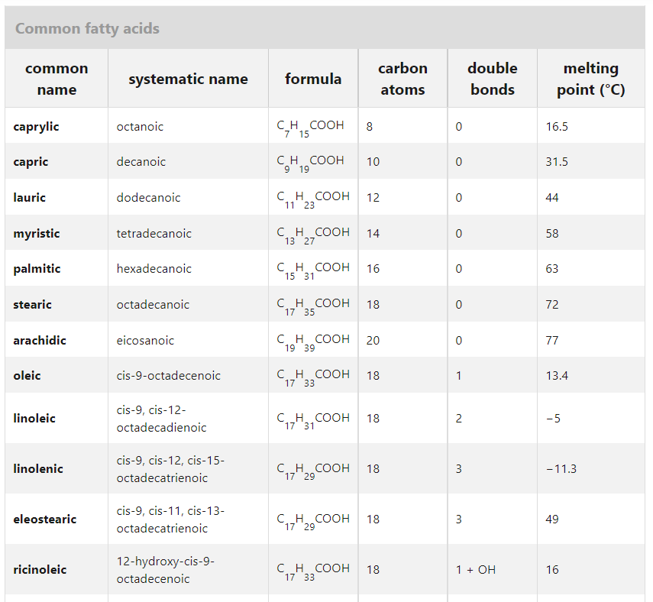
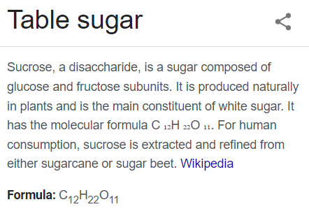
Most* food turns into CO2 and H20! * 10-20%?
Fat (molecules) we eat

Slide 13
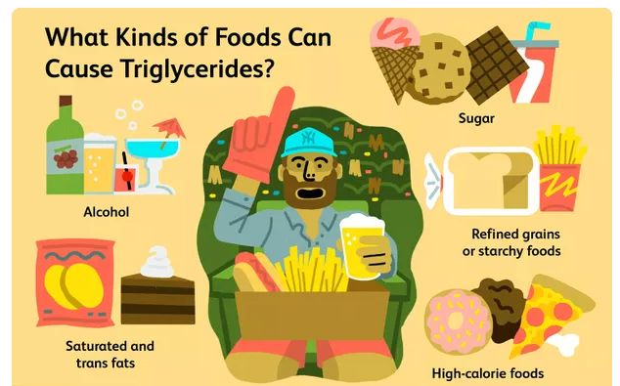
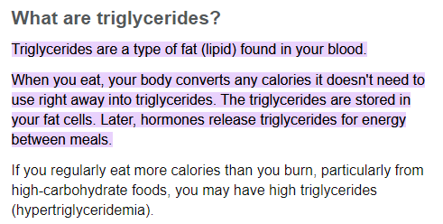
What happens to that food energy?
Force*
distance
Food > Blood Sugar > Fat > Blood Sugar > Muscles > Body heat > Environment
Stomach & gut
Blood
Fat Tissue
Blood
Muscles
Blood Sugar
Fat (Lipids)
Blood Sugar
Environmental heat
Food
Body Heat
Acid + micro-biome
Liver
Muscle (actin)
Sweat, breath
Liver
Notes:
Food > blood sugar > Fat tissue > Sugar > muscles > climb a hill
https://www.mayoclinic.org/diseases-conditions/high-blood-cholesterol/in-depth/triglycerides/art-20048186
https://www.verywellhealth.com/what-foods-cause-high-triglycerides-1087467

Slide 14
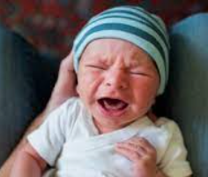
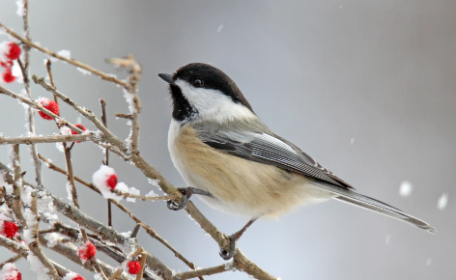
What happens to that food energy?
Force*
distance
Food > Blood Sugar > Fat > Blood Sugar > Muscles > Body heat > Environment
Stomach & gut
Blood
Fat Tissue
Blood
Muscles
Blood Sugar
Fat (Lipids)
Blood Sugar
Environmental heat
Food
Body Heat
Acid + micro-biome
Liver
Muscle (actin)
Sweat, breath
Liver
If you don’t have Fat tissue, how often do you need to eat?
Notes:
Food > blood sugar > Fat tissue > Sugar > muscles > climb a hill
https://www.mayoclinic.org/diseases-conditions/high-blood-cholesterol/in-depth/triglycerides/art-20048186
https://www.verywellhealth.com/what-foods-cause-high-triglycerides-1087467

Slide 15


Slide 16
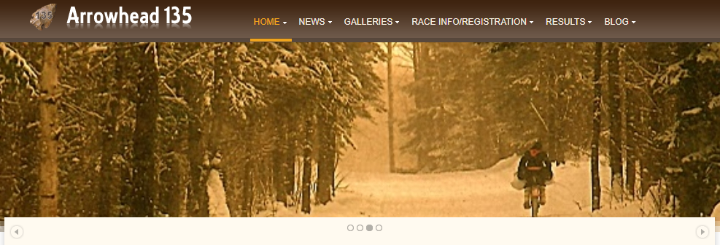
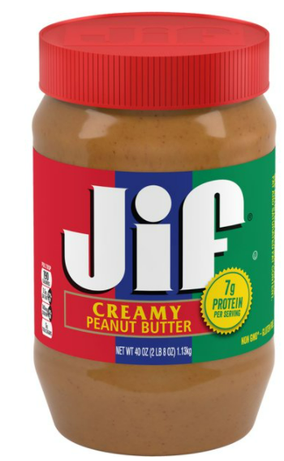
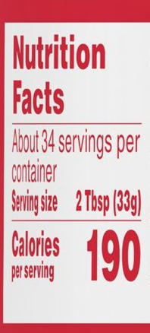
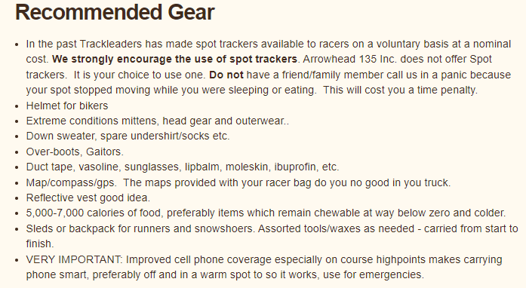
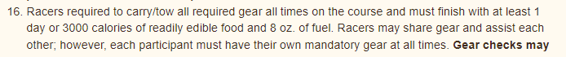
A jar of peanut butter is not a joke!
190kcal * 34 servings ~ 6400kcal
Notes:
International Falls to Tower MN. 135 miles, Jan 31-Feb 2: 7am Monday to 7pm Wednesday
http://www.arrowheadultra.com/

Slide 17
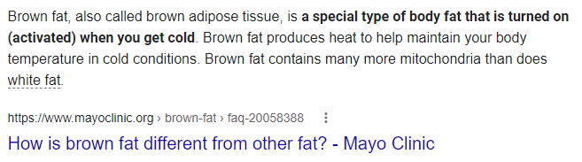
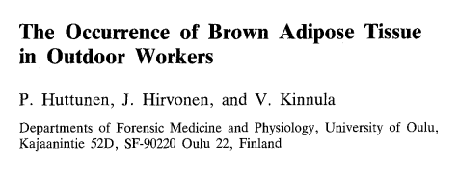
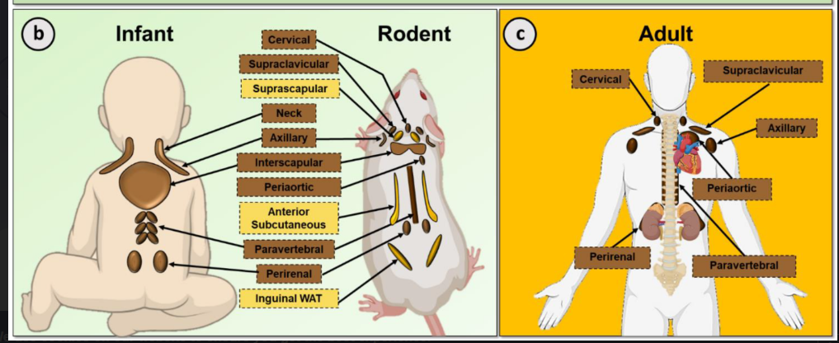

Slide 18
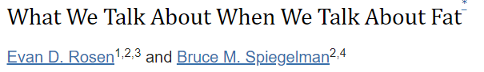
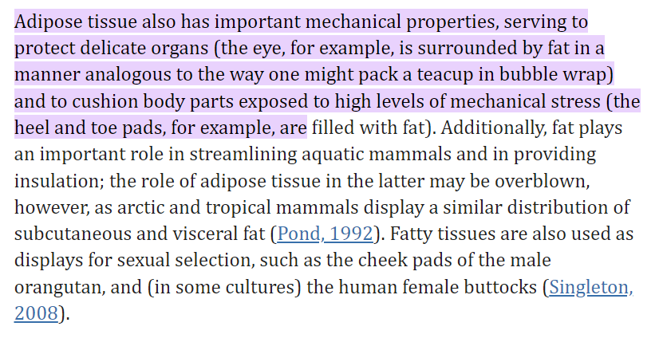


Slide 19
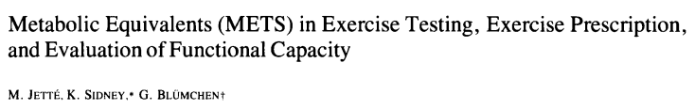
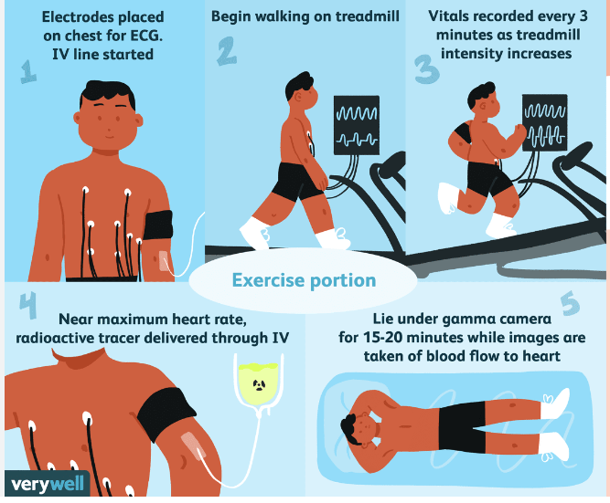
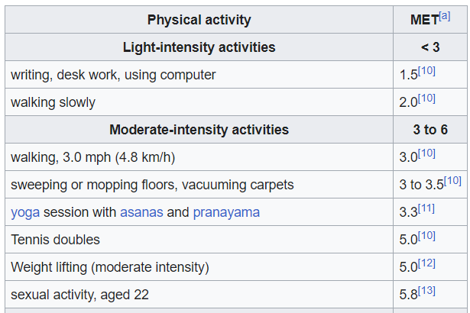

$$1MET=\frac{1 kcal}{kg⋅hour}=\frac{85kcal}{85kg⋅hour}=\frac{2040kcal}{85kg⋅day}$$

Slide 20
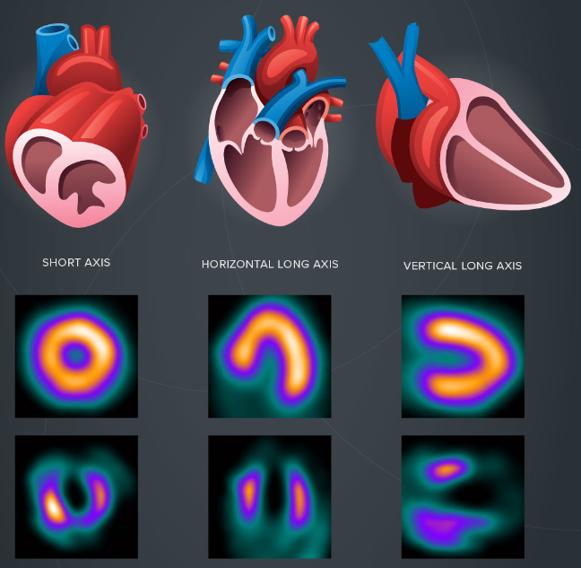

Slide 21
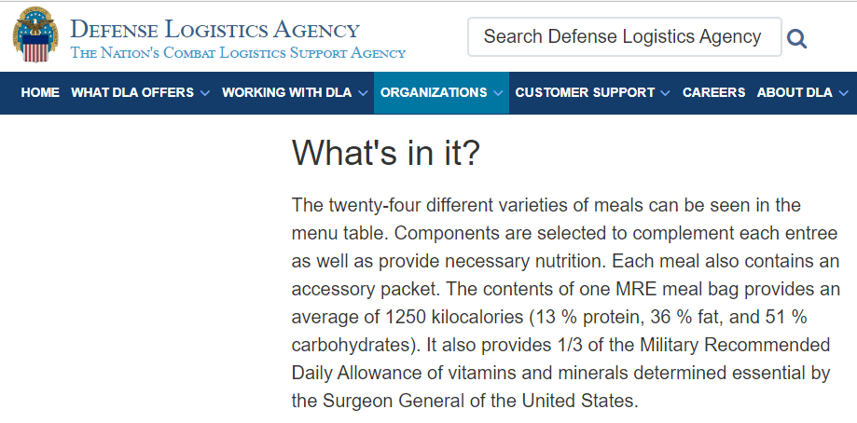
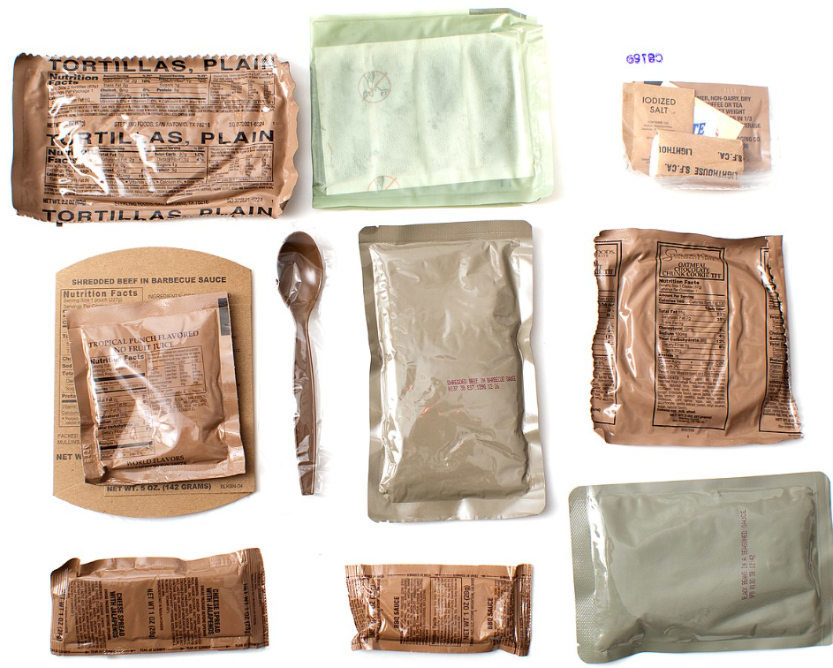
Where did 3000kcal/day come from?

Slide 22

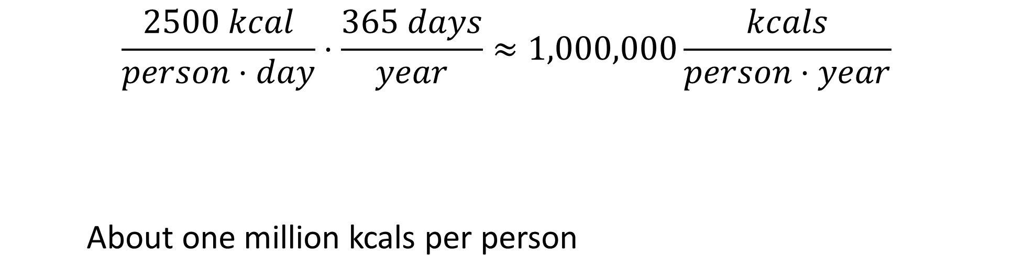
Each year?
$$\frac{2500 kcal}{person⋅day}⋅\frac{365 days}{year}≈1,000,000\frac{kcals}{person⋅year}$$
About one million kcals per person

Slide 23
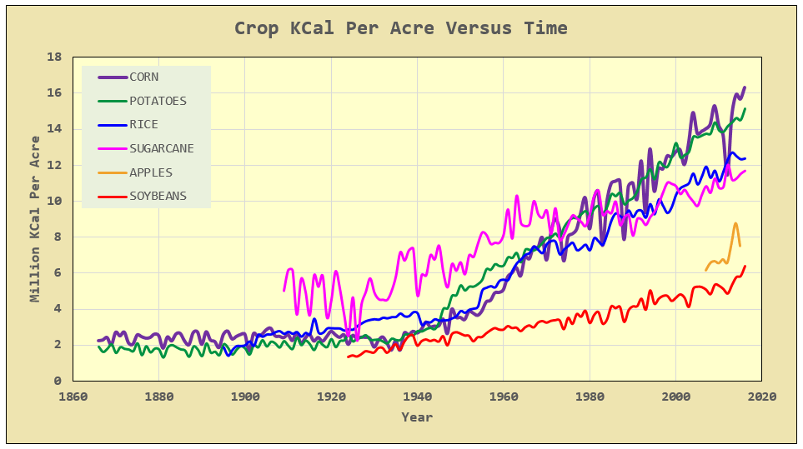
How do we get those kcals?
People fed per acre
Notes:
Via math encounters blog, USDA data

Slide 24
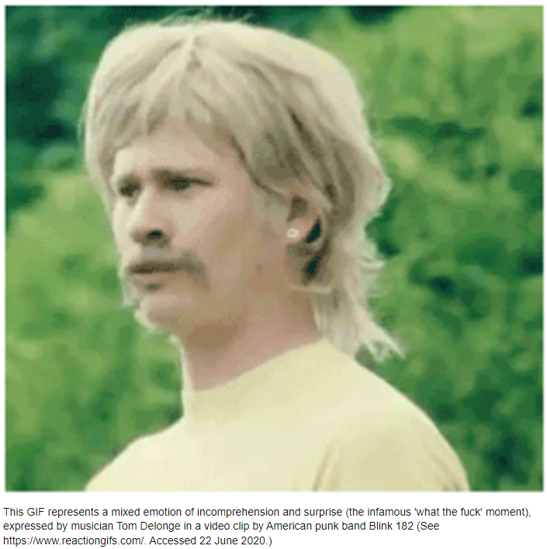
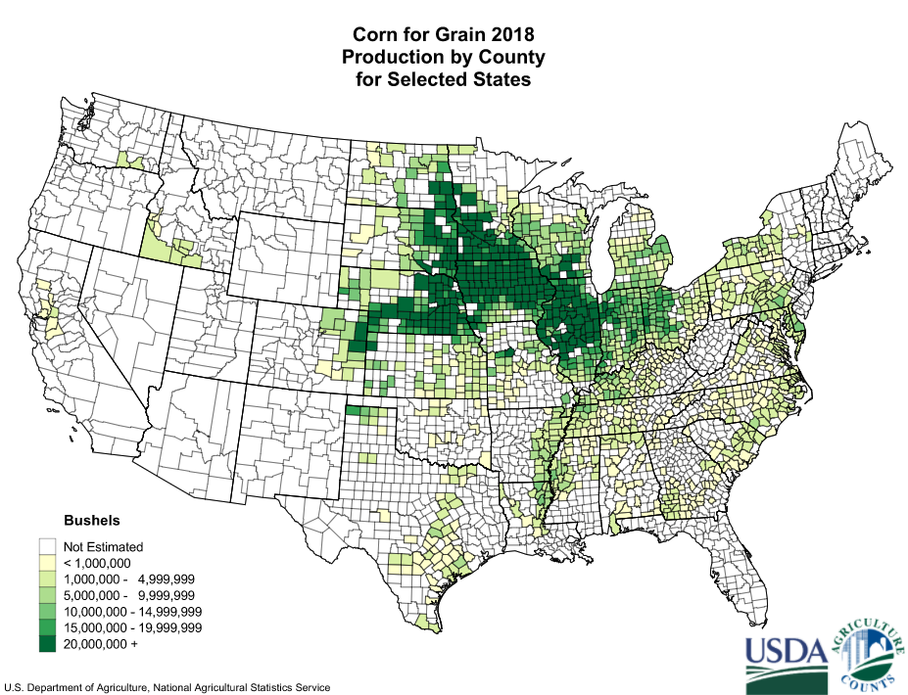
@15M kcal/acre: if we only fed the US corn, how much area would be needed?
Iowa, 36M acres
So why do we grow so much corn?
Notes:
https://en.wikipedia.org/wiki/Corn_Belt 330M M kcals means about 22M acres
Total area: Iowa 36M acres, IL 37M acres

Slide 25
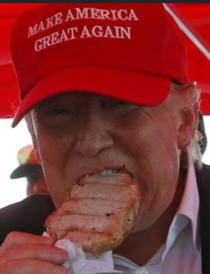
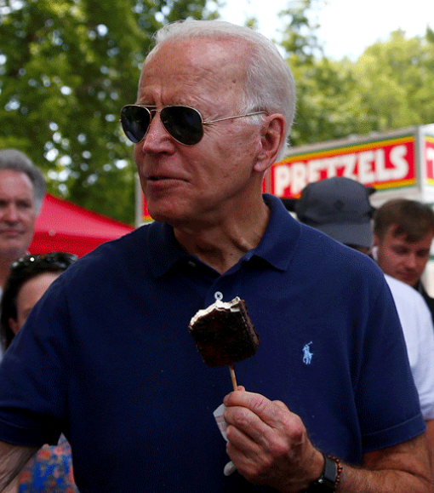
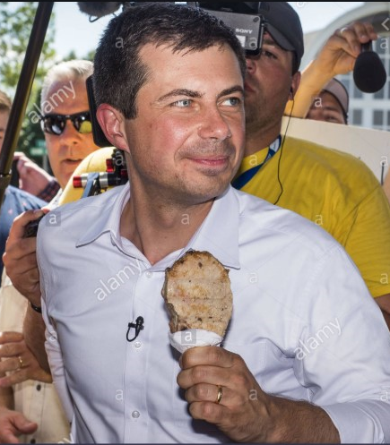
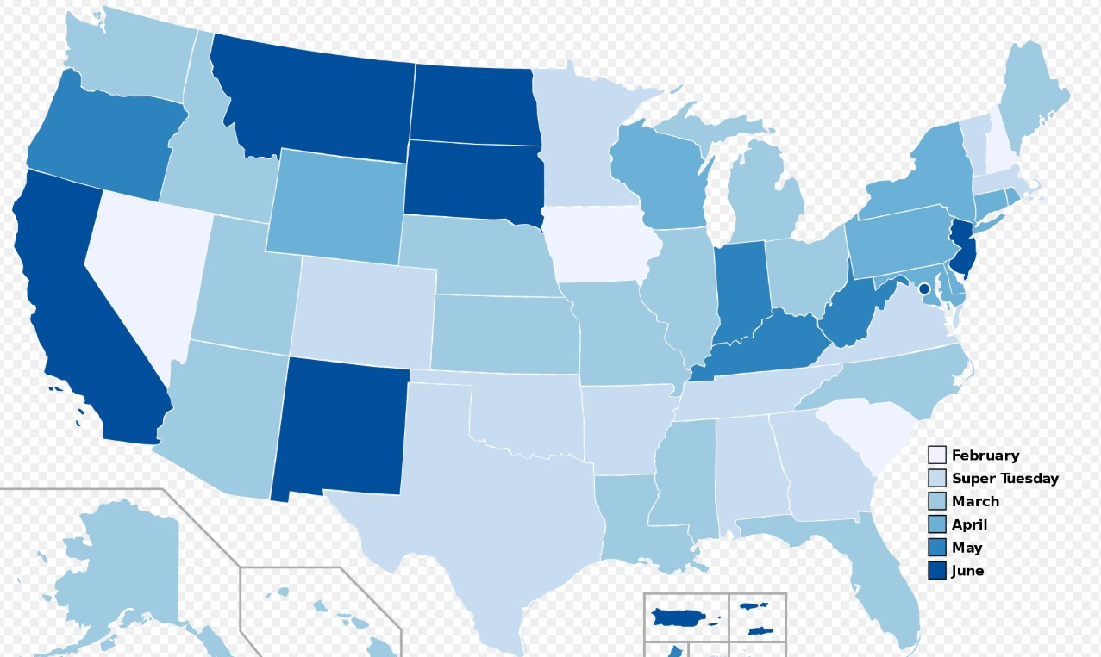

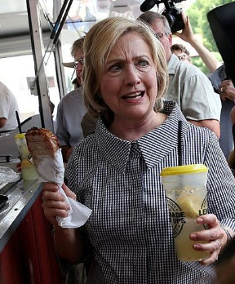

Notes:
Note, D and R presidential primary schedules are very similar. In both cases, Iowa (caucus) is first. https://en.wikipedia.org/wiki/United_States_presidential_primary
https://www.alamy.com/des-moines-iowa-usa-13th-aug-2019-pete-buttigieg-with-the-pork-chop-on-a-stick-he-bought-at-the-iowa-state-fair-buttigieg-the-mayor-of-south-bend-indiana-is-running-to-be-the-democratic-nominee-for-the-us-presidency-he-spoke-at-the-des-moines-register-political-soap-box-at-the-iowa-state-fair-and-then-toured-the-fairgrounds-iowa-has-the-first-event-of-the-presidential-selection-cycle-the-iowa-caucuses-are-february-3-2020-credit-jack-kurtzzuma-wirealamy-live-news-image264045119.html
https://politicalmurder.com/2019/08/06/forget-polls-what-will-democrats-eat-and-what-policies-will-they-tout-at-the-iowa-state-fair/
https://www.wsj.com/articles/presidential-candidates-beware-the-iowa-state-fair-11565185289
https://www.google.com/imgres?imgurl=https%3A%2F%2Fwww.orlandosentinel.com%2Fresizer%2FG9FQ3qrdfZNehcbAc7mIPikq2BI%3D%2F415x280%2Ftop%2Farc-anglerfish-arc2-prod-tronc.s3.amazonaws.com%2Fpublic%2F55OFHEYJNI3YVG2LVHQJDK2XKQ.jpg&imgrefurl=https%3A%2F%2Fwww.orlandosentinel.com%2Fopinion%2Fscott-maxwell-commentary%2Fos-op-iowa-caucus-florida-recount-hacking-scott-maxwell-20200205-pgfbihueirbgzb7lxca5hmyoni-story.html&tbnid=D8yuKHm5mKdB-M&vet=12ahUKEwjr_Z3_g-bpAhUHhKwKHeGhAOIQMygWegQIARAw..i&docid=YdBgkBY3EtgErM&w=415&h=280&q=iowa%20caucus%20politicians%20state%20fair%20pork%20chop&safe=active&ved=2ahUKEwjr_Z3_g-bpAhUHhKwKHeGhAOIQMygWegQIARAw
https://www.google.com/imgres?imgurl=https%3A%2F%2Fsi.wsj.net%2Fpublic%2Fresources%2Fimages%2FBN-JV635_IOWAFA_M_20150813121243.jpg&imgrefurl=https%3A%2F%2Fwww.wsj.com%2Farticles%2Frepublican-presidential-contenders-flock-to-iowa-state-fair-1439508432&tbnid=zBxxiMYJ89GJTM&vet=12ahUKEwjr_Z3_g-bpAhUHhKwKHeGhAOIQMygVegQIARAu..i&docid=vMa1AvJbCuHwfM&w=1280&h=853&q=iowa%20caucus%20politicians%20state%20fair%20pork%20chop&safe=active&ved=2ahUKEwjr_Z3_g-bpAhUHhKwKHeGhAOIQMygVegQIARAu

Slide 26
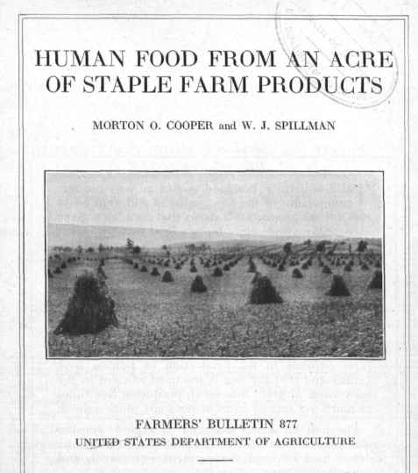
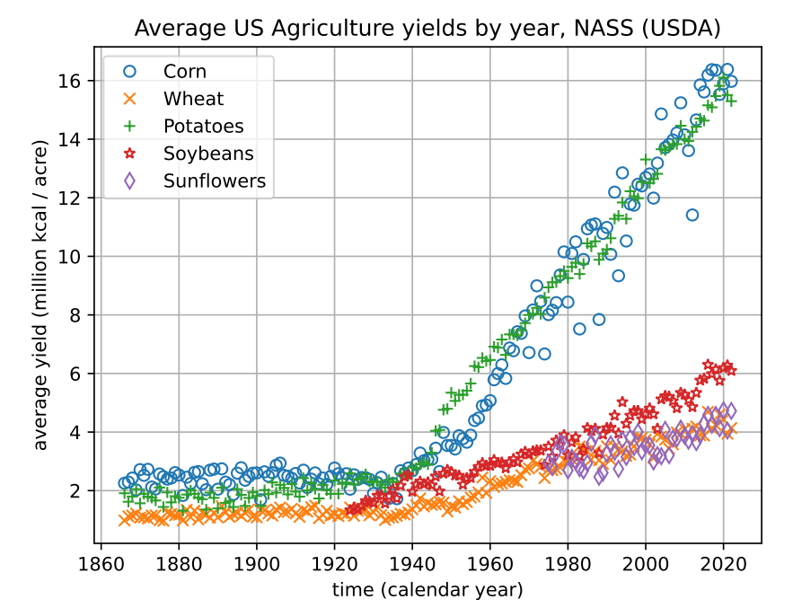
What if you want to DIY?
Notes:
1917, WWI, non-chemical horse/ox/manure-based agriculture

Slide 27
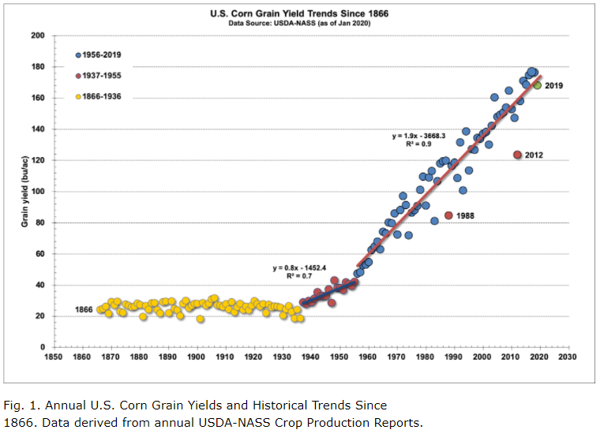
WW1
WW2
Notes:
https://www.agry.purdue.edu/ext/corn/news/timeless/YieldTrends.html

Slide 28
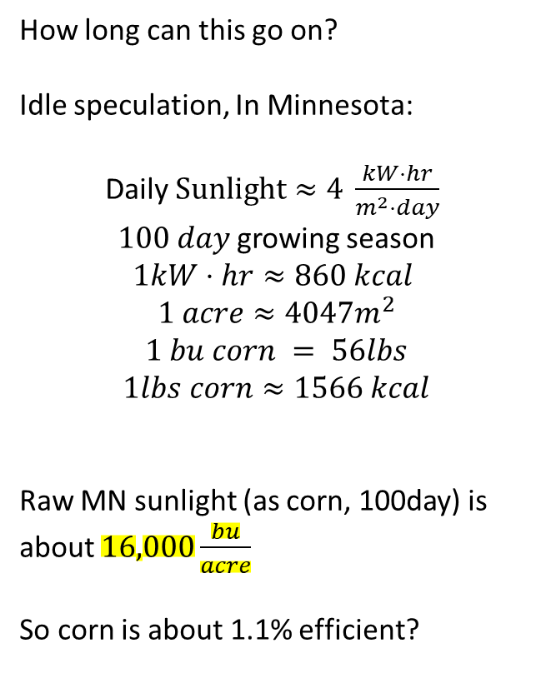
How long can this go on?
Idle speculation, In Minnesota:
Daily $Sunlight≈4 \frac{kW⋅hr}{m^{2}⋅day}$
$100 day$growing season
$$1kW⋅hr≈860 kcal$$
$$1 acre≈4047m^{2}$$
$$1 bu corn = 56lbs$$
$$1lbs corn≈1566 kcal$$
Raw MN sunlight (as corn, 100day) is about $16,000\frac{bu}{acre}$
So corn is about 1.1% efficient?
200 bu/acre
Notes:
https://www.agry.purdue.edu/ext/corn/news/timeless/YieldTrends.html

Slide 29
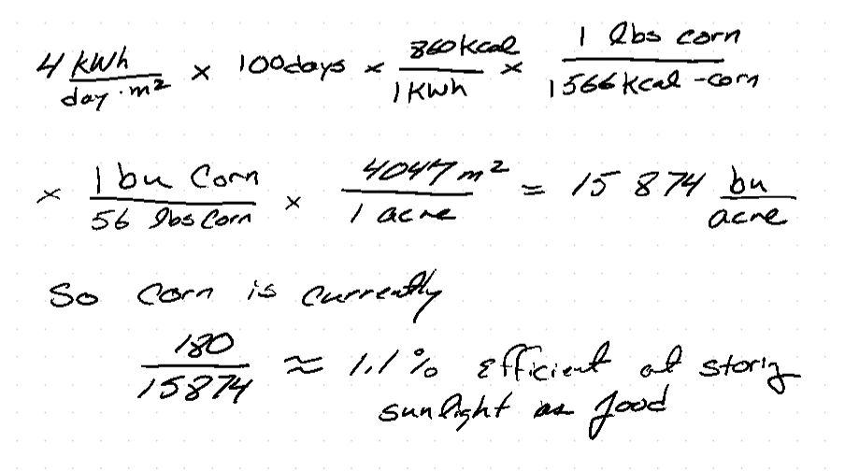
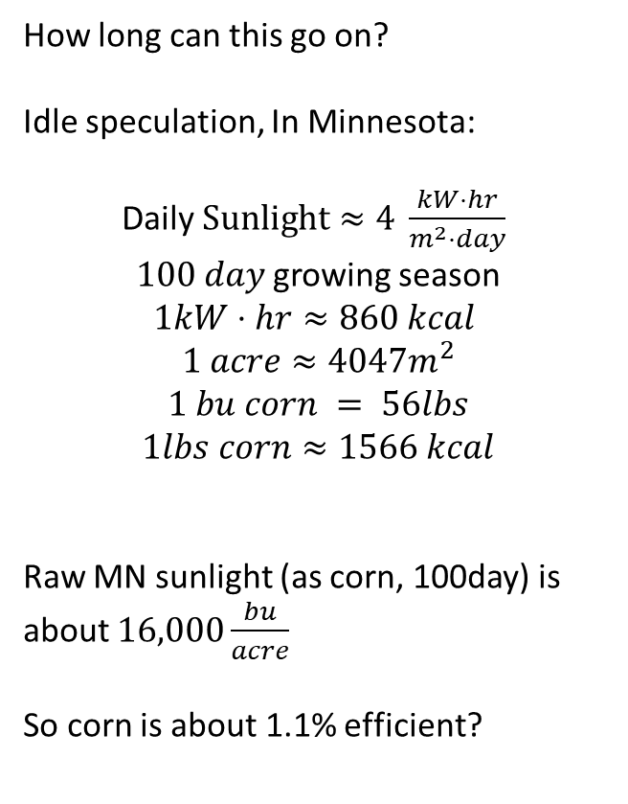
How long can this go on?
Idle speculation, In Minnesota:
Daily $Sunlight≈4 \frac{kW⋅hr}{m^{2}⋅day}$
$100 day$growing season
$$1kW⋅hr≈860 kcal$$
$$1 acre≈4047m^{2}$$
$$1 bu corn = 56lbs$$
$$1lbs corn≈1566 kcal$$
Raw MN sunlight (as corn, 100day) is about $16,000\frac{bu}{acre}$
So corn is about 1.1% efficient?
Notes:
https://www.agry.purdue.edu/ext/corn/news/timeless/YieldTrends.html

Slide 30
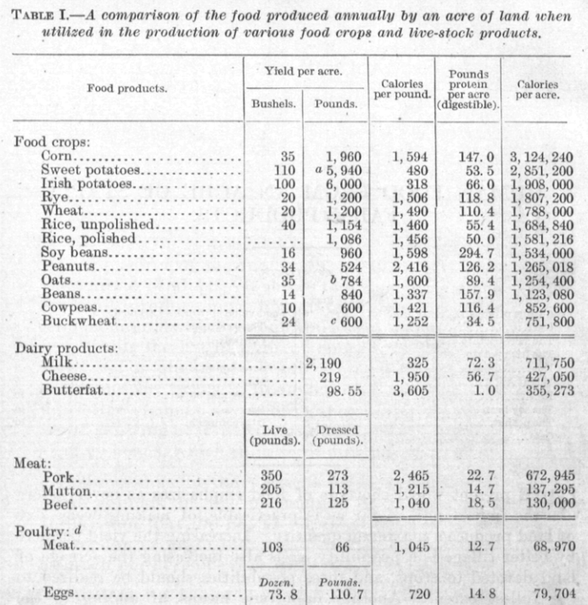
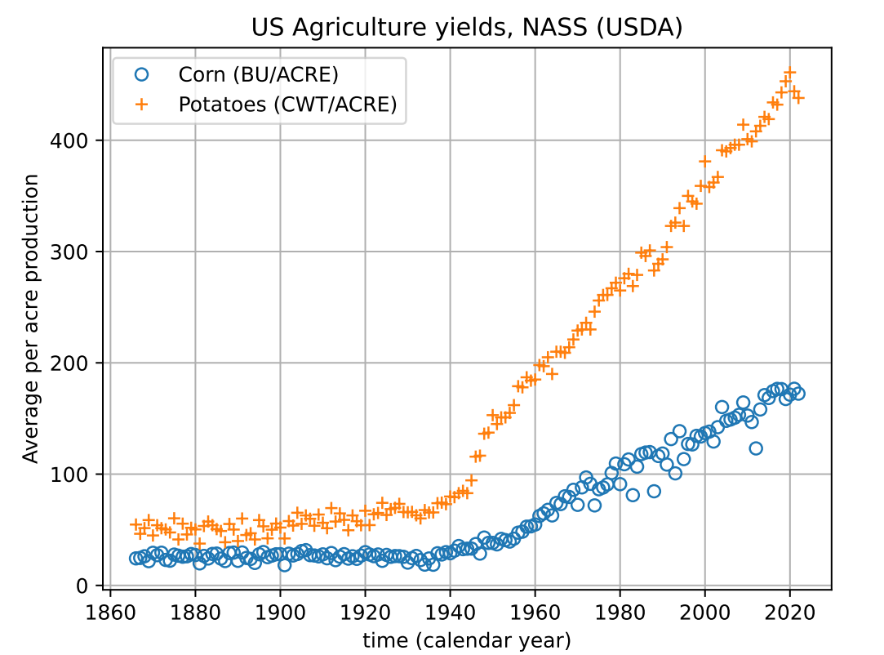
Notes:
Note the poor feed conversion efficiency of crops to meat. FYI, crickets are about 1:1 while modern “broiler” chickens are about 1.6:1

Slide 31
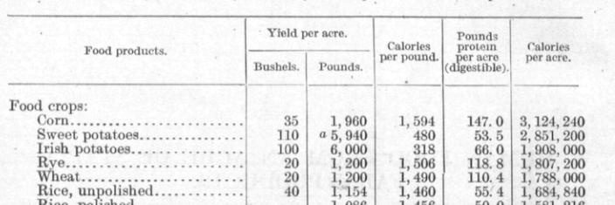
6 people, 1 year, how many acres of potatoes?
Notes:
Maybe ½ acre per person with potatoes?

Slide 32







In terms of Winona 6 people need:
In 1917 “Irish” Potatoes yield $1.9M\frac{kcal}{acre}$
6ppl need $6M\frac{kcal}{year}$
So about 3 acres of potatoes

Slide 34

2nd Half of the talk

Slide 35


Can Ireland live off backyard potatoes?

Slide 36


Notes:
https://en.wikipedia.org/wiki/Demographics_of_the_Republic_of_Ireland

Slide 37







Can Ireland live off of potatoes?
~8.5M ppl in 1845 need $9.3×{10}^{12} kcal$
$84,000 km^{2}$of land, 64% arable, so $54,000km^{2}$ can be used for ag
https://arxiv.org/abs/2301.06637

Slide 38
Potato Crop Failures
Notes:
https://en.wikipedia.org/wiki/Demographics_of_the_Republic_of_Ireland

Slide 39
Potato Crop Failures
Famine is a political choice
Famine is a Human Disaster, not a natural disaster
Notes:
https://en.wikipedia.org/wiki/Demographics_of_the_Republic_of_Ireland

Slide 40

Third Horseman of the Apocalypse: Famine
Not scarcity, but allocation
Notes:
https://en.wikipedia.org/wiki/Four_Horsemen_of_the_Apocalypse

Slide 42
3rd Half of the talk

Slide 43

https://www.npr.org/sections/thesalt/2016/06/13/481586649/a-map-of-where-your-food-originated-may-surprise-you
https://colostate.pressbooks.pub/cropwildrelatives/chapter/introduction-to-crop-wild-relatives/
Notes:
https://www.npr.org/sections/thesalt/2016/06/13/481586649/a-map-of-where-your-food-originated-may-surprise-you
https://colostate.pressbooks.pub/cropwildrelatives/chapter/introduction-to-crop-wild-relatives/

Slide 44
https://www.npr.org/sections/thesalt/2016/06/13/481586649/a-map-of-where-your-food-originated-may-surprise-you
https://colostate.pressbooks.pub/cropwildrelatives/chapter/introduction-to-crop-wild-relatives/
Notes:
https://www.npr.org/sections/thesalt/2016/06/13/481586649/a-map-of-where-your-food-originated-may-surprise-you
https://colostate.pressbooks.pub/cropwildrelatives/chapter/introduction-to-crop-wild-relatives/

Slide 45

How does the world get their kcals today?
Notes:
What about North America???
https://en.wikipedia.org/wiki/Staple_food

Slide 46



How did the Americas get their kcals in 1491?
In 1491 there were ~50M people in N. America and ~70M people in Europe. The Americans were a primarily agricultural society. What did they eat? (for 7 centuries!!!)
Tenochtitlan was 200-400k people in 1491!
Notes:
For a reference on the population estimates, see https://uwpress.wisc.edu/books/0289.htm
Graph from https://en.wikipedia.org/wiki/Population_history_of_indigenous_peoples_of_the_Americas

Slide 47

In 1491, the Aztecs:
Were a HUGE society (50M people!)
Tenochtitlan was ~= Minneapolis !
Had NO draft animals
Had NO farm animals
Had NO large animals (eg bison) to hunt
Had NO large-scale whaling
Produced lots of art depicting human sacrifice and cannibalism.
1970’s Zeitgeist

Slide 48


In 1491, the Aztecs:
Were a HUGE society (50M people!)
Tenochtitlan was ~= Minneapolis !
Had NO draft animals
Had NO farm animals
Had NO large animals (eg bison) to hunt
Had NO large-scale whaling
Produced lots of art depicting human sacrifice and cannibalism.
So… Cannibalism was a response to protein deficiency during famine years?

Slide 49

Or, calm down and run the numbers…
Gross!
An opportunity for Claim-Evidence-Reasoning?
Notes:
https://en.wikipedia.org/wiki/The_Population_Bomb

Slide 50




Slide 51




Are you normally starving to death during the holidays or the harvest?

Slide 52


Reasoning: What fraction of Americans get 100% of their protein from Turkey or Lamb???
https://www.statista.com/statistics/189222/average-meat-consumption-in-the-us-by-sort/

Slide 53


How do you grow 7 crops a year, two of them maize (corn)?

Slide 54


Slide 55




Slide 56


Notes:
“Chinampas were essentially man-made islands, raised bed gardens on the surface of Lake Texcoco’s shallow waters.”
https://www.historyonthenet.com/aztec-agriculture-floating-farms-fed-the-people
https://en.wikipedia.org/wiki/Chinampa

Slide 57


https://imagej.net/ij/

Slide 58

16,000 acres @ 38bu/acre would feed 100,000 people
Notes:
“Chinampas were essentially man-made islands, raised bed gardens on the surface of Lake Texcoco’s shallow waters.”
https://www.historyonthenet.com/aztec-agriculture-floating-farms-fed-the-people
https://en.wikipedia.org/wiki/Chinampa

Slide 59


https://arxiv.org/abs/2301.06637

Slide 61

Sadly, Professor Moore is the only survivor of a plane crash in Alaska. Fortunately, the crash is adjacent a mountain stream that’s filled with trout. From a map in the survival kit, he estimates that the hike downstream will take 5 days.
Should he (a) start hiking immediately,
or (b) spend a week catching and smoking trout so that he’ll have food to eat while on the hike.
There are ripe wild berries along the path.
Information: 1 trout contains about 120 Calories of food energy; 1 lb of raspberries contains 240 Calories; Prof Moore is overweight at 22% body fat, or ~18kg of body fat. Human body fat contains about 3500 Calories per pound.

Slide 62

All businesses must be handicap accessible (per the ADA).
What if it were the law that every business must have free food available?

